Slide 1
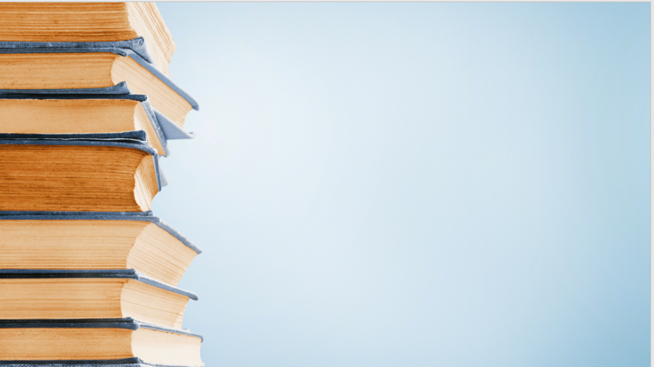
Future Outlook Science and technology education economy, development and industry
Presented by: SUMMIYA

Slide 2
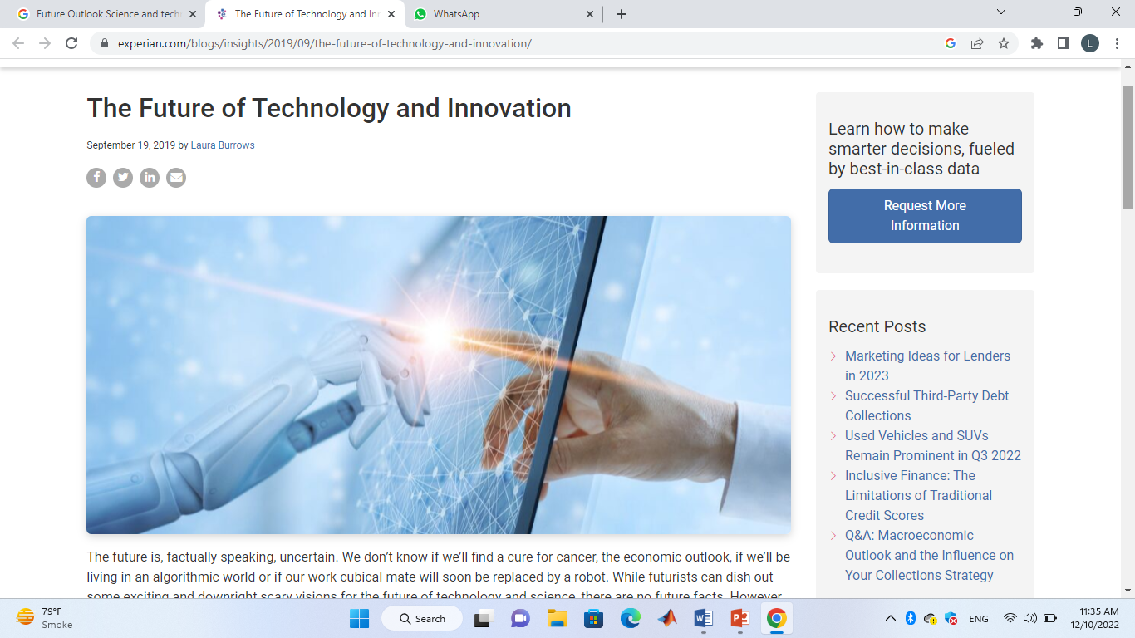
Outlook for Future Science
The massive growth of global research activity in recent years has spurred studies exploring how productive this expansion has been and what the future may hold.

Slide 3

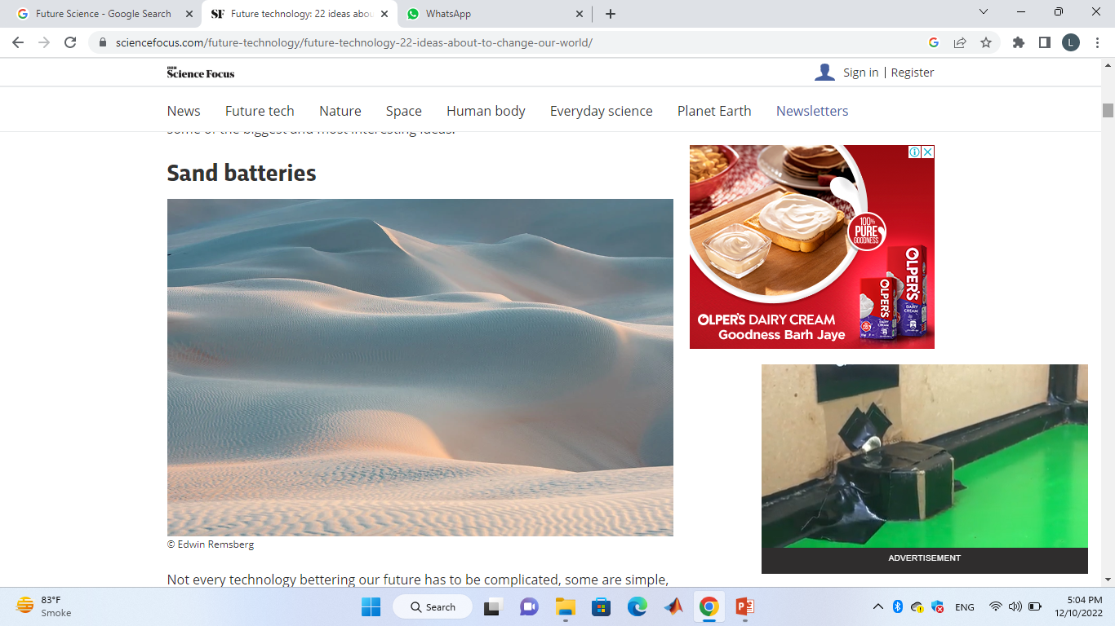
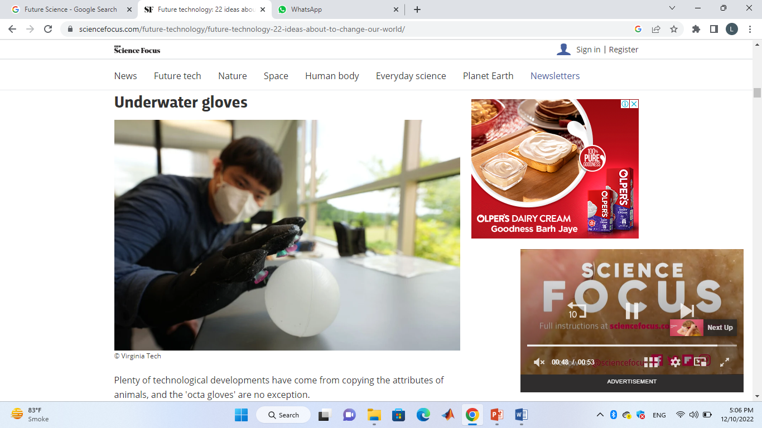
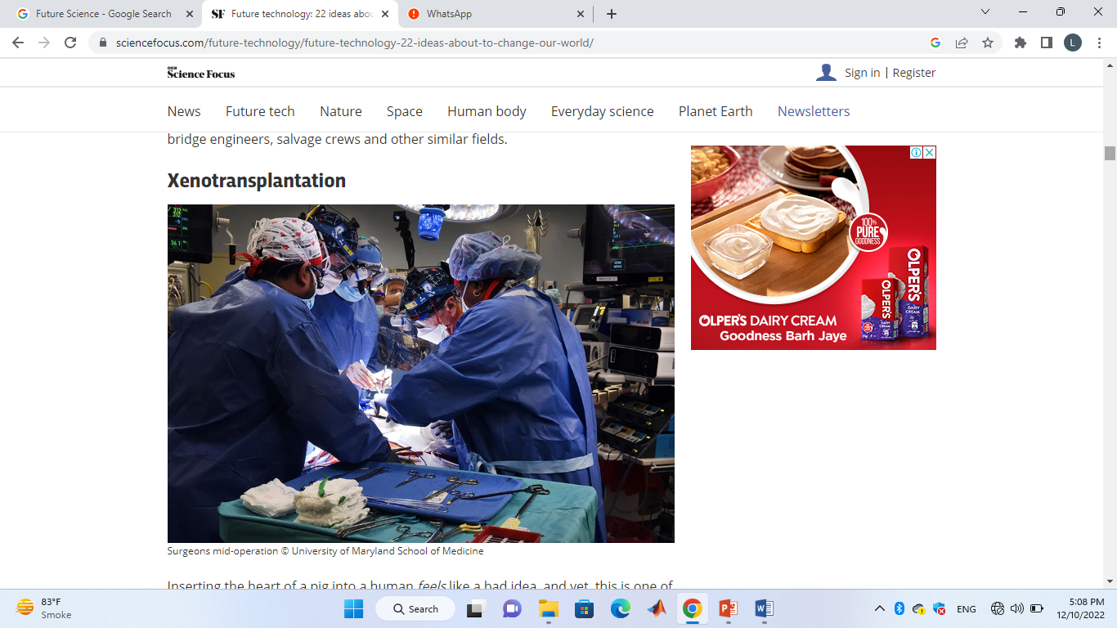
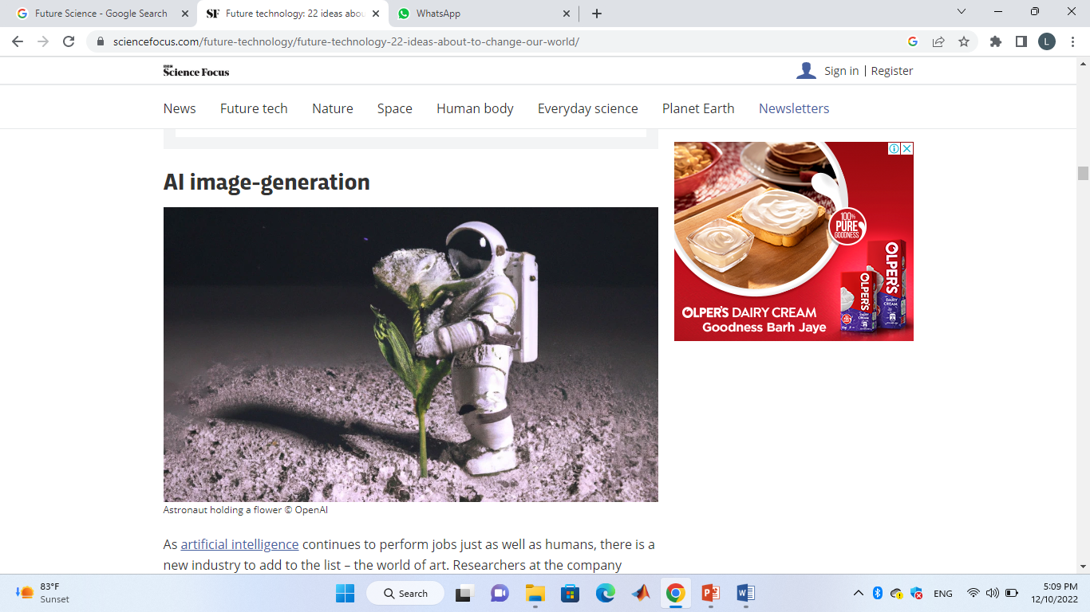
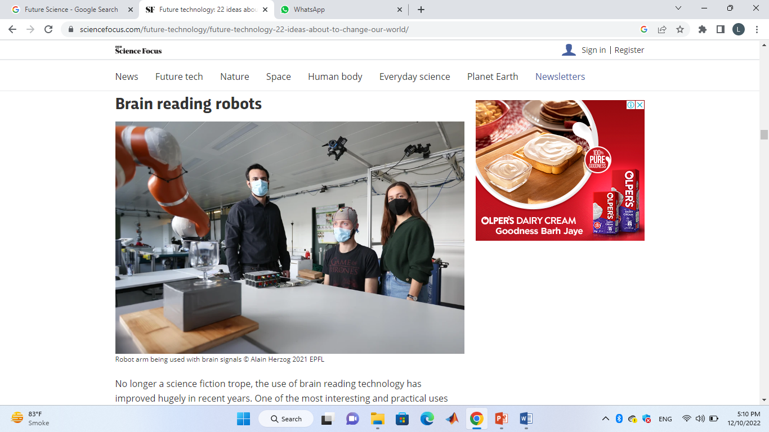
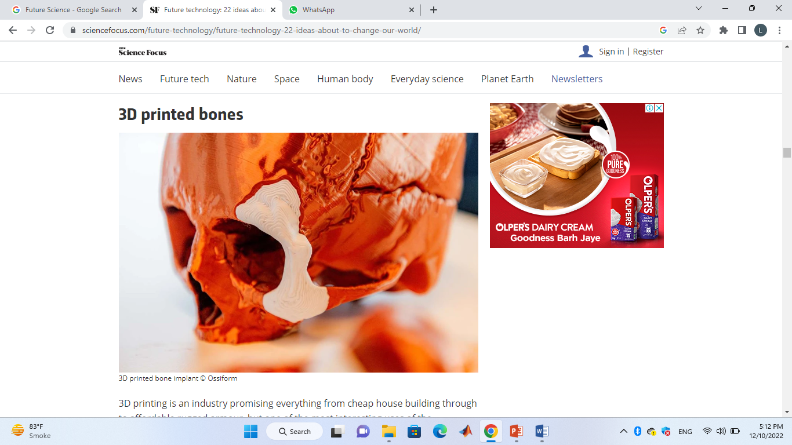
Future SCIENCE
The future is coming, and sooner than you think. These emerging technologies will change the way we live.
Sand batteries
Underwater gloves
Xenotransplantation
AI image-generation
Brain reading robots
3D printed bones

Slide 4
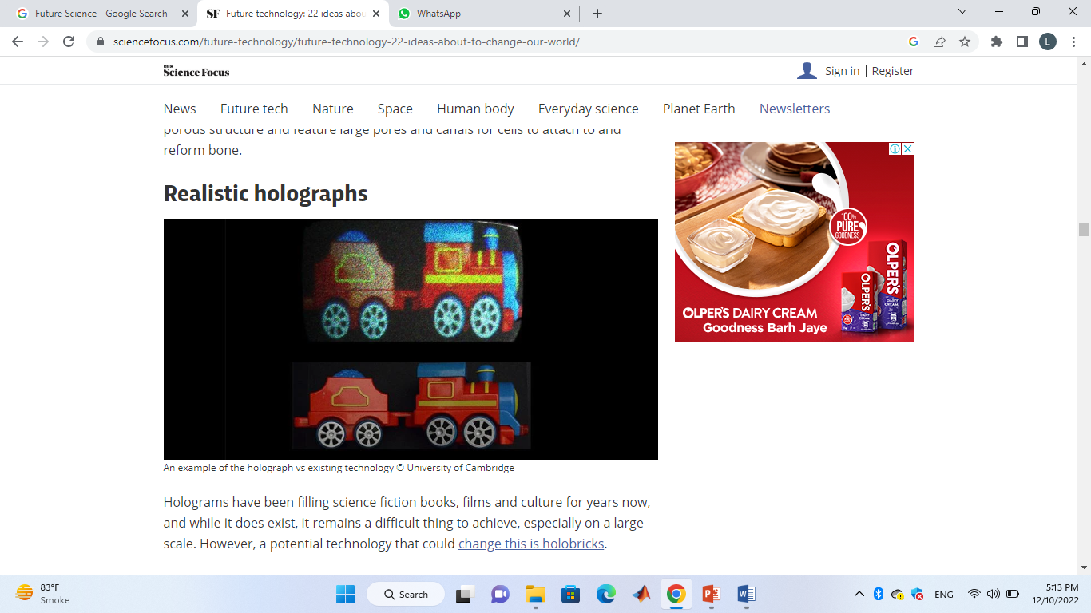
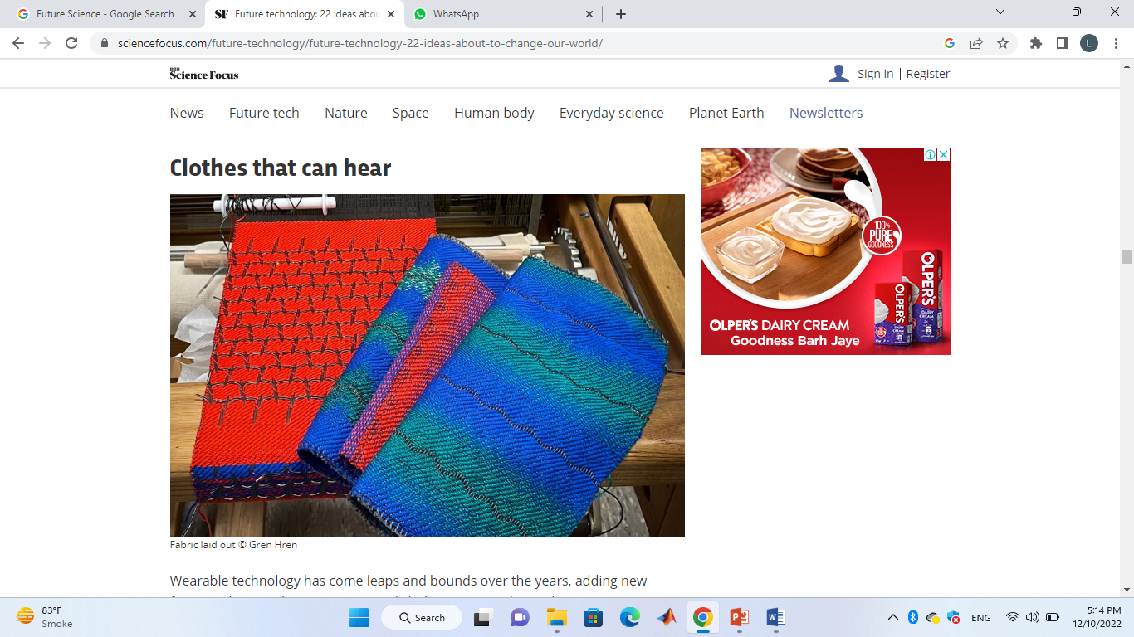
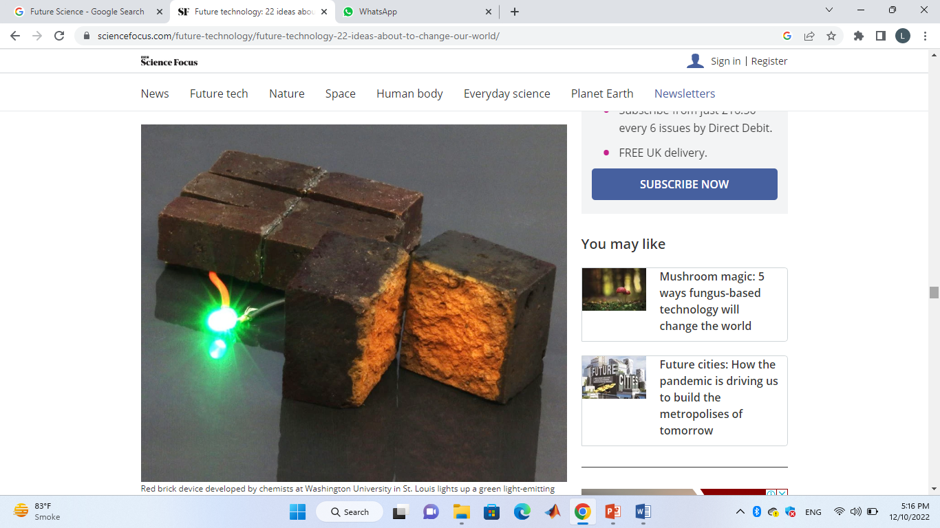
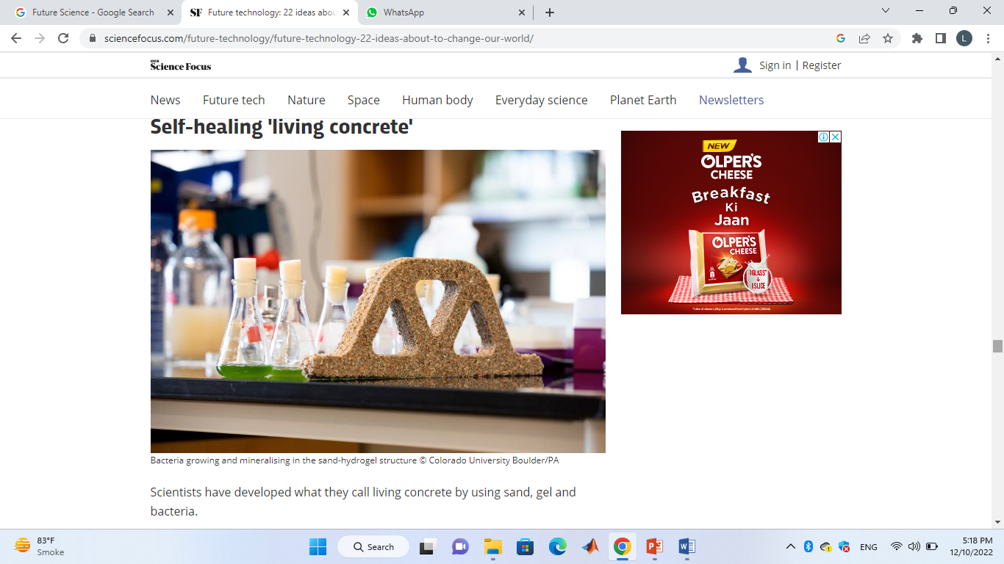
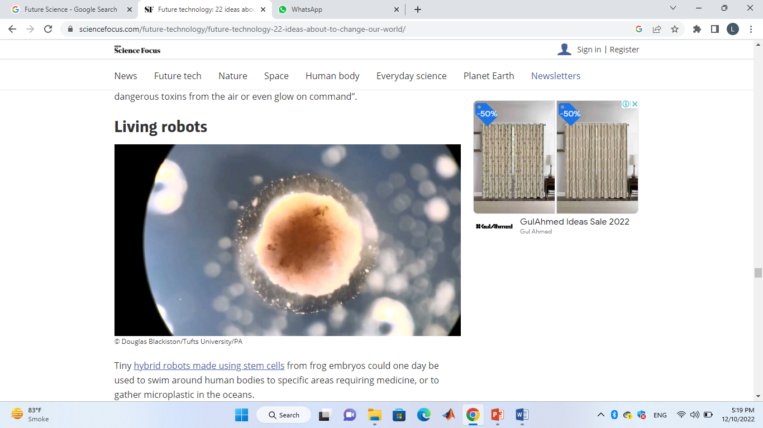
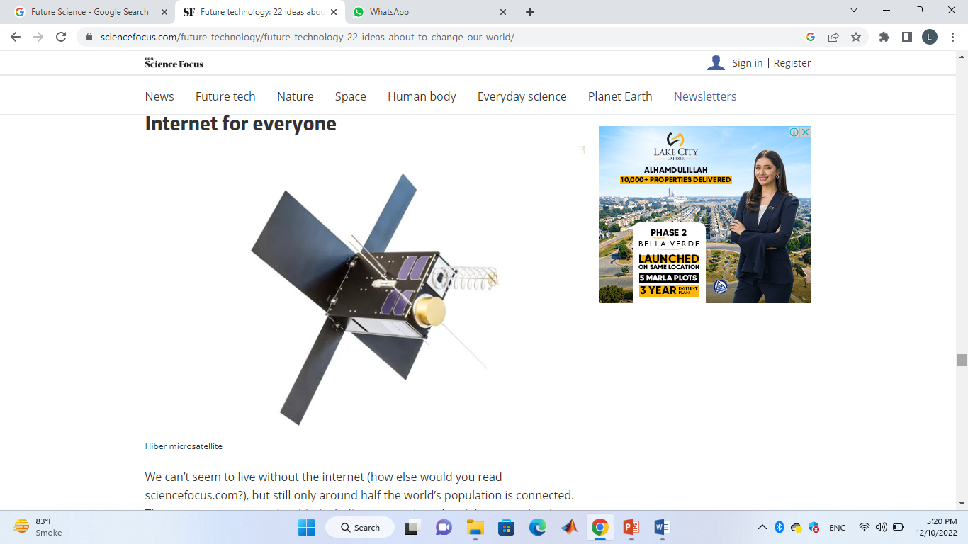
Realistic holographs
Clothes that can hear
Energy storing bricks
Self-healing 'living concrete’
Living robots
Internet for everyone

Slide 5
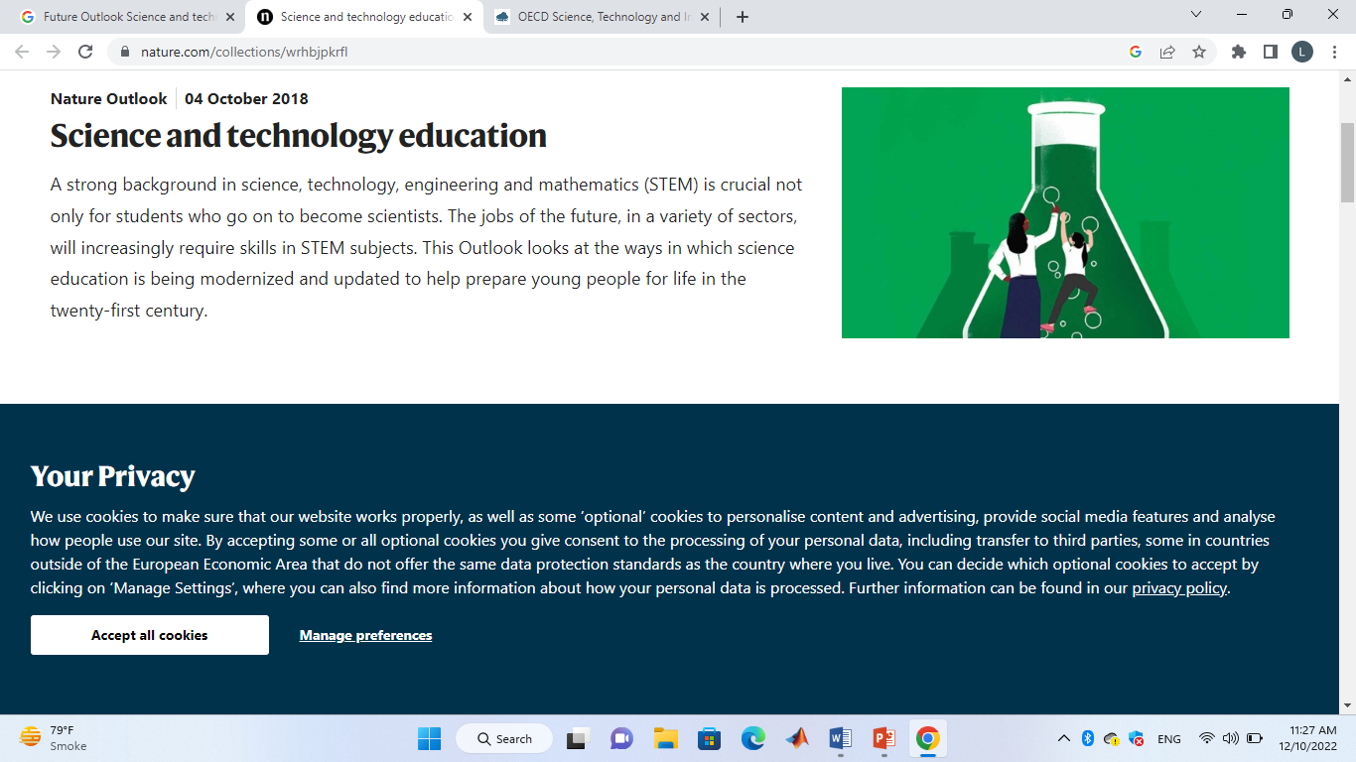
k.’
Science and Technology Education
S → Science
T → Technology
E → Education
M → Mathematics
STEM is crucial need for the development
of nation in every aspect of life.

Slide 6

technology Is shaping the future of education
Easy access to a wide choice of updated material
Improves communication skills and performance
Makes learning fun and engaging
Stay connected through the net
Stay current

Slide 7

The future of education technology
Tablets in Classrooms
Assistive Technology
Augmented Reality/Virtual Reality and Voice Platforms

Slide 8

different edtech tools used by teachers in education
Demand-based learning
Student insight
Cloud computing
Voice recognition technology
Learning through virtual reality
3D printing
Gamification
Artificial intelligence

Slide 9


